Slide 1
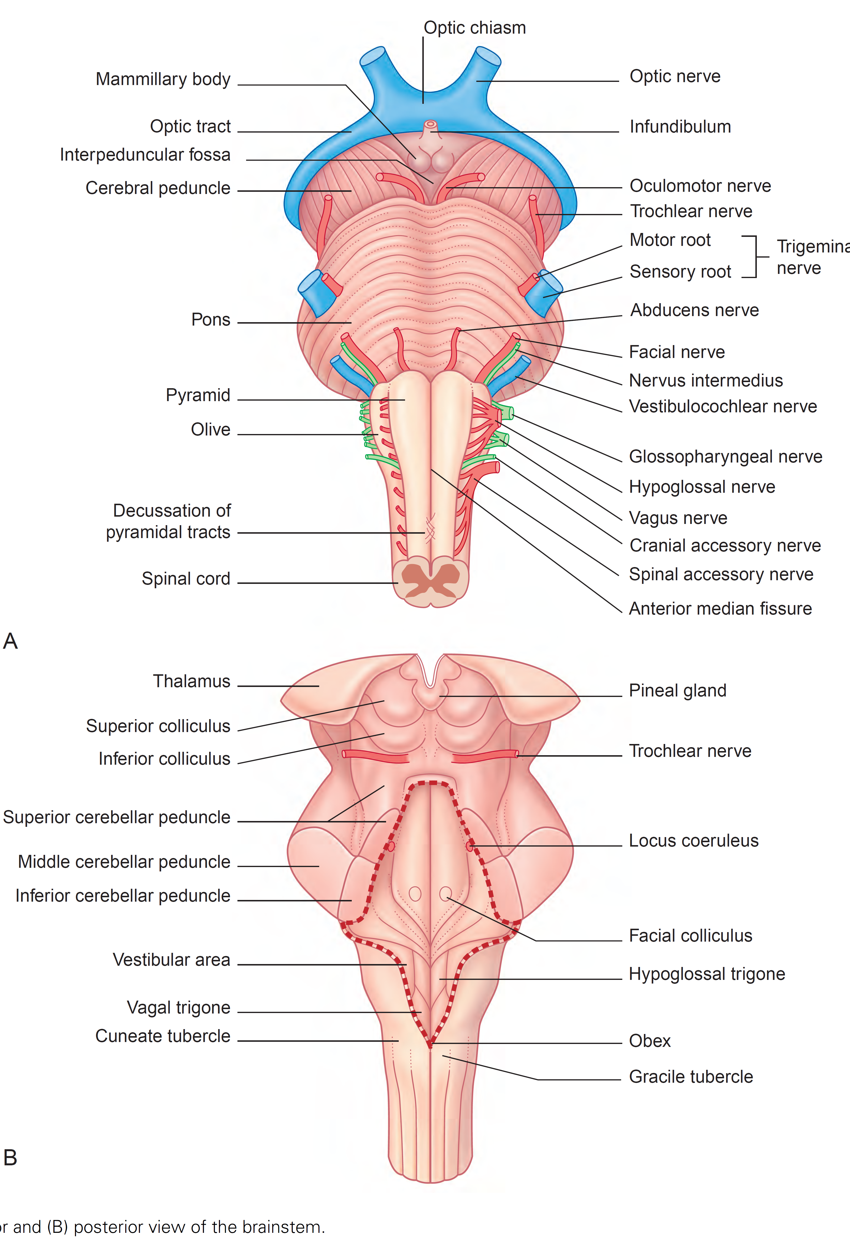
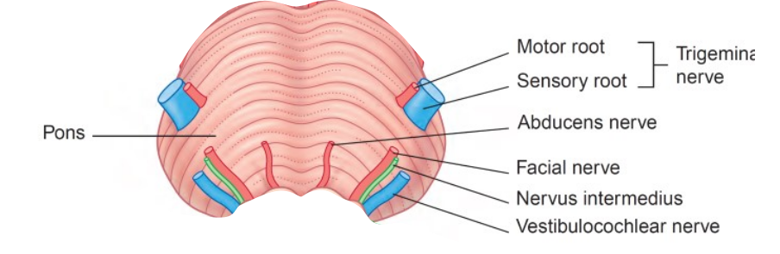
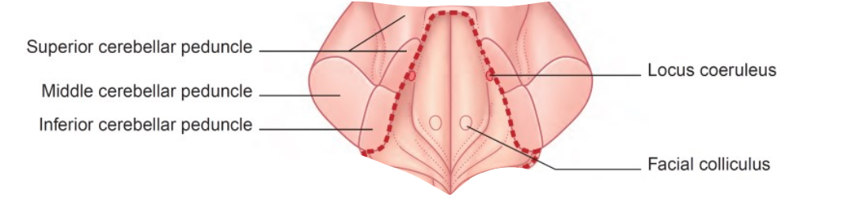
Cranial nerves of the pons

Slide 2
VIII - Vestibulocochlear

Slide 3
VII - Facial

Slide 4
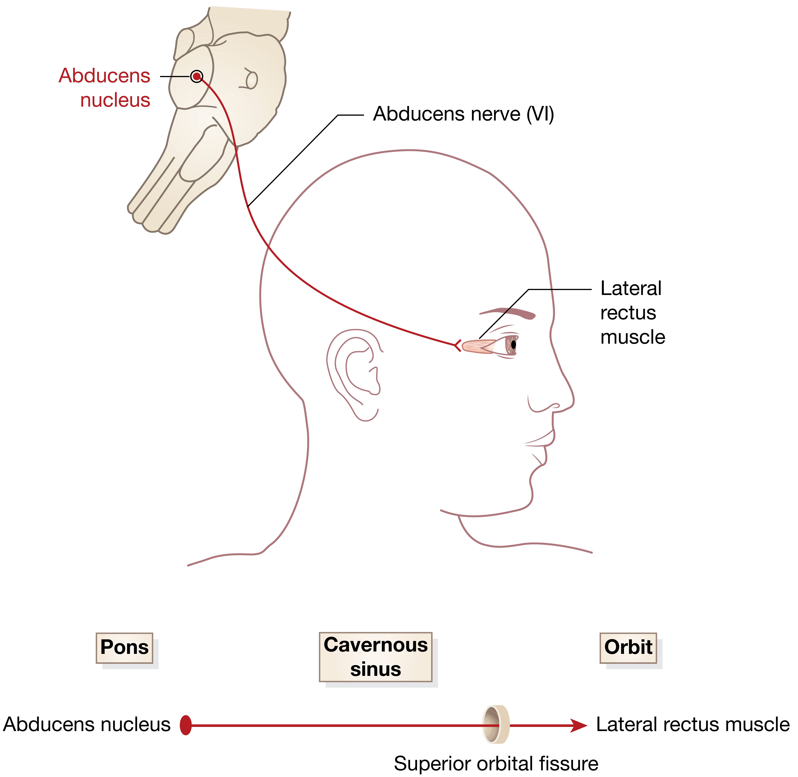
VI - Abducens

Slide 5
V - Trigeminal

Slide 6
Cranial nerves of the pons
Number | Nerve | Nuclei | Targets
VII | Vestibulocochlear | Vestibular nuclei Cochlear nuclei | Semicircular canals or the maculae of the utricle and saccule Organ of Corti of the cochlea
VII | Facial | Spinal trigeminal nucleus Nucleus solitarious Facial nucleus Superior salivatory nucleus | General sensation from a small portion of the external auditory meatus Taste from front 2/3 of the tongue Stapedius muscle Muscles of facial expression Stylohyoid muscle and posterior belly of digastric muscle Nasal mucosa, lacrimal gland, submandibular and sublingual salivary glands
VI | Abducens | Nucleus abducens | Lateral rectus muscle of the eye
V | Trigeminal | Main sensory nucleus Spinal trigeminal nucleus Motor nucleus of trigeminal | General sensation of the face Temporalis, masseter, medial, and lateral Pterygoid mastication muscles Mylohyoid, the anterior belly of the digastric, the tensor tympani, and the tensor veli palatini accessory muscles

Slide 7
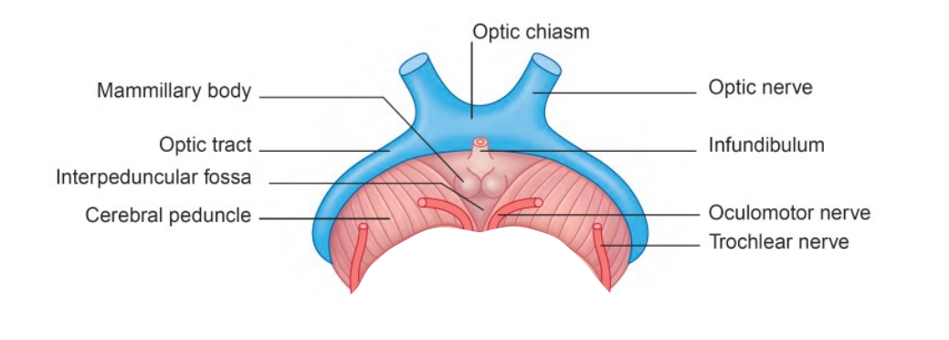
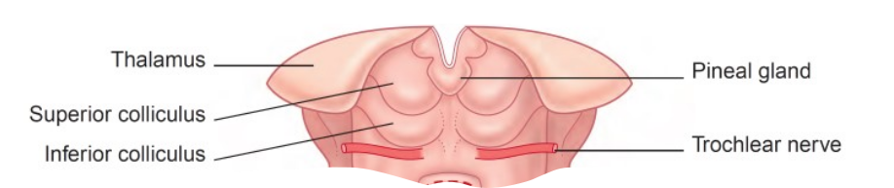
The midbrain

Slide 8
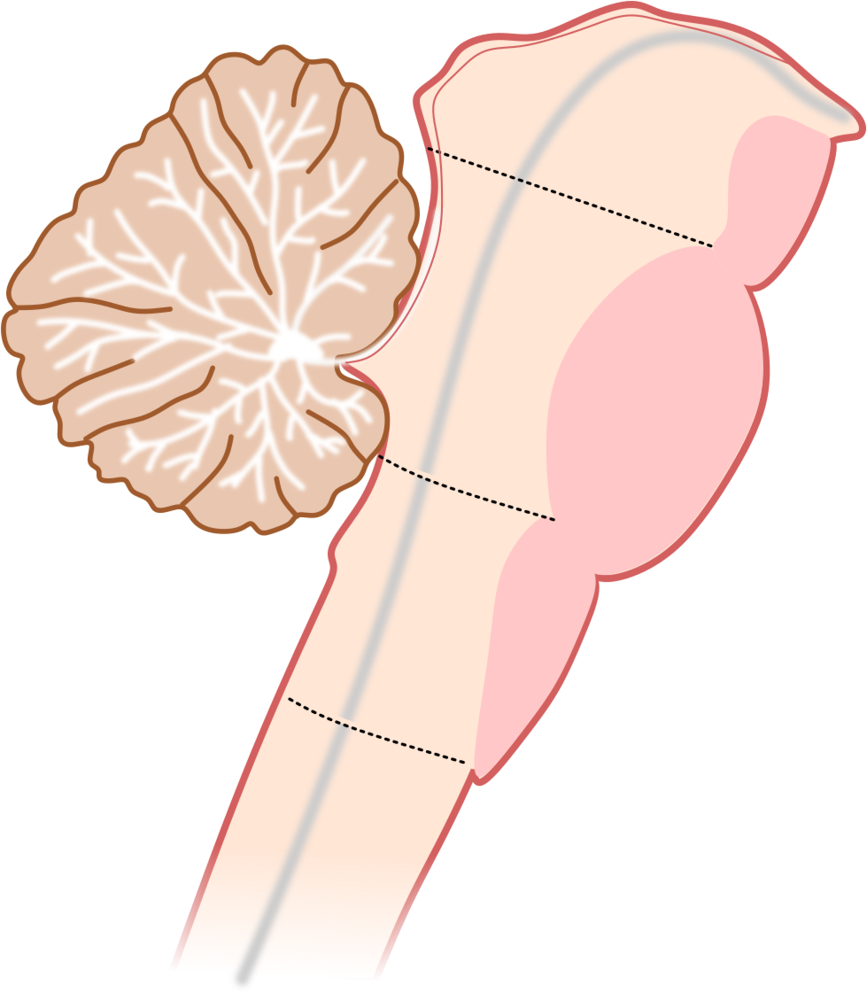
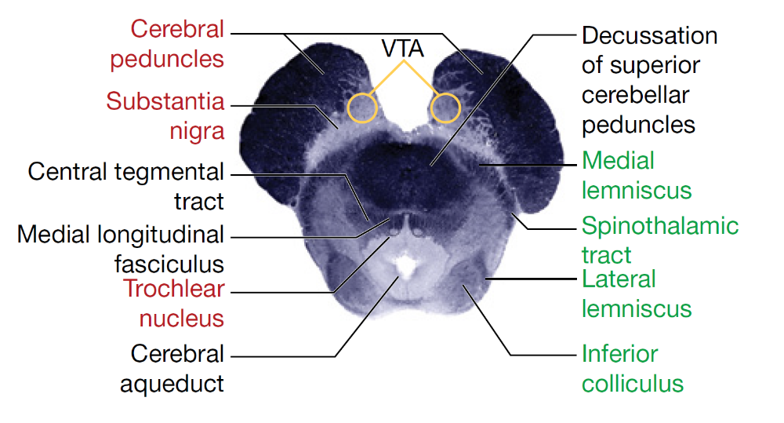
The midbrain
Midbrain
Pons
Medulla
Oblungata
Sensory
Motor

Slide 9
Cranial nerves of the midbrain

Slide 10
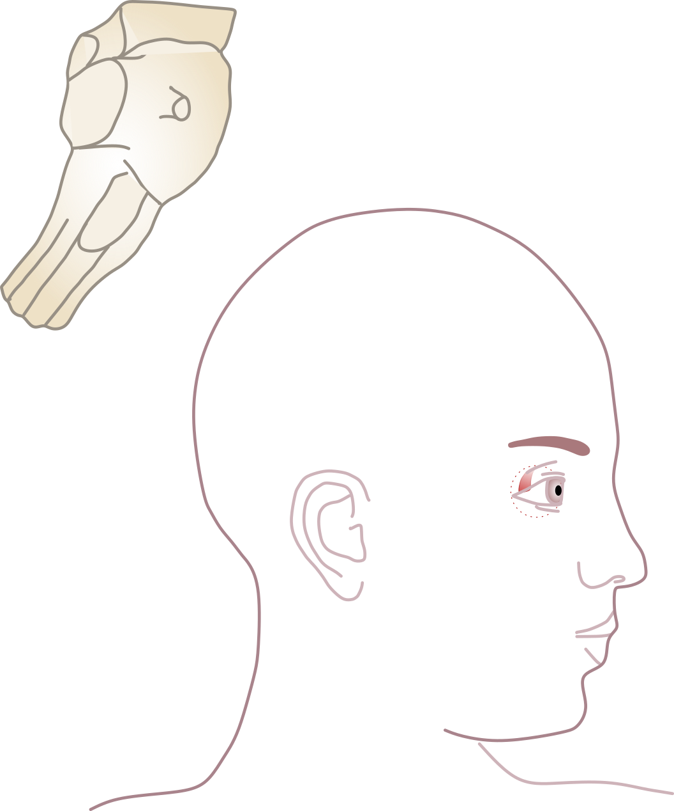
IV - Trochlear
Trochlear
Nucleus
Cerebellar
peduncles
Cavernous sinus
Orbit
Midbrain
Superior orbital
fissure
Eye muscles
Oculomotor
Nucleus
Superior oblique

Slide 11
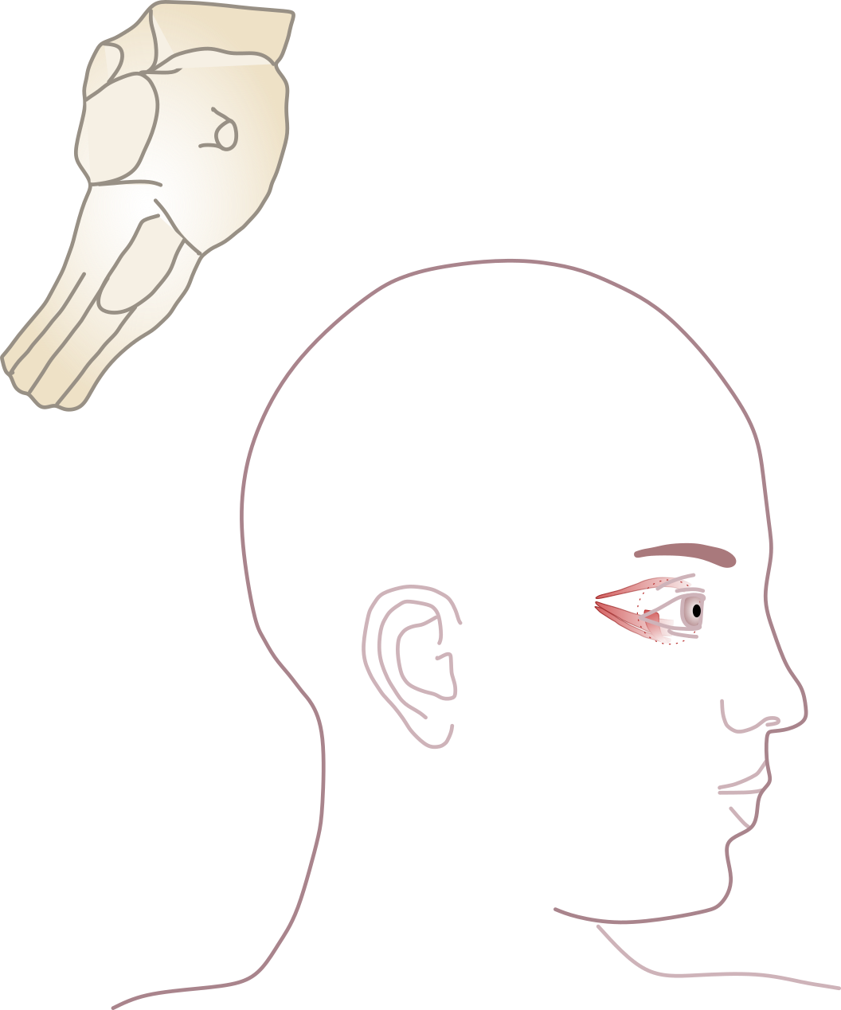
III - Oculomotor
Edinger-Westphal
Nucleus
Oculomotor
Nucleus
Cerebellar
peduncles
Cavernous sinus
Orbit
Midbrain
Eye muscles
Superior orbital
fissure
Superior rectus
Medial rectus
Inferior rectus
Inferior oblique
Levator palpebrae superioris
Oculomotor
Nucleus
Ciliary
Ganglion
Edinger-Westphal
Nucleus
Celiac
ganglion
Constrictor pupillae
Ciliary

Slide 12
Cranial nerves of the midbrain
Number | Nerve | Nuclei | Targets
IV | Trochlear | Trochlear | Superior oblique muscle of the eye
III | Oculomotor | Oculomotor Nucleus of Edinger‐Westphal | Levator palpebrae superioris muscle of the eye Superior rectus muscle of the eye Medial rectus muscle of the eye Inferior rectus muscle of the eye Inferior oblique muscle of the eye Sphincter pupillae muscle and ciliary muscle

Slide 13
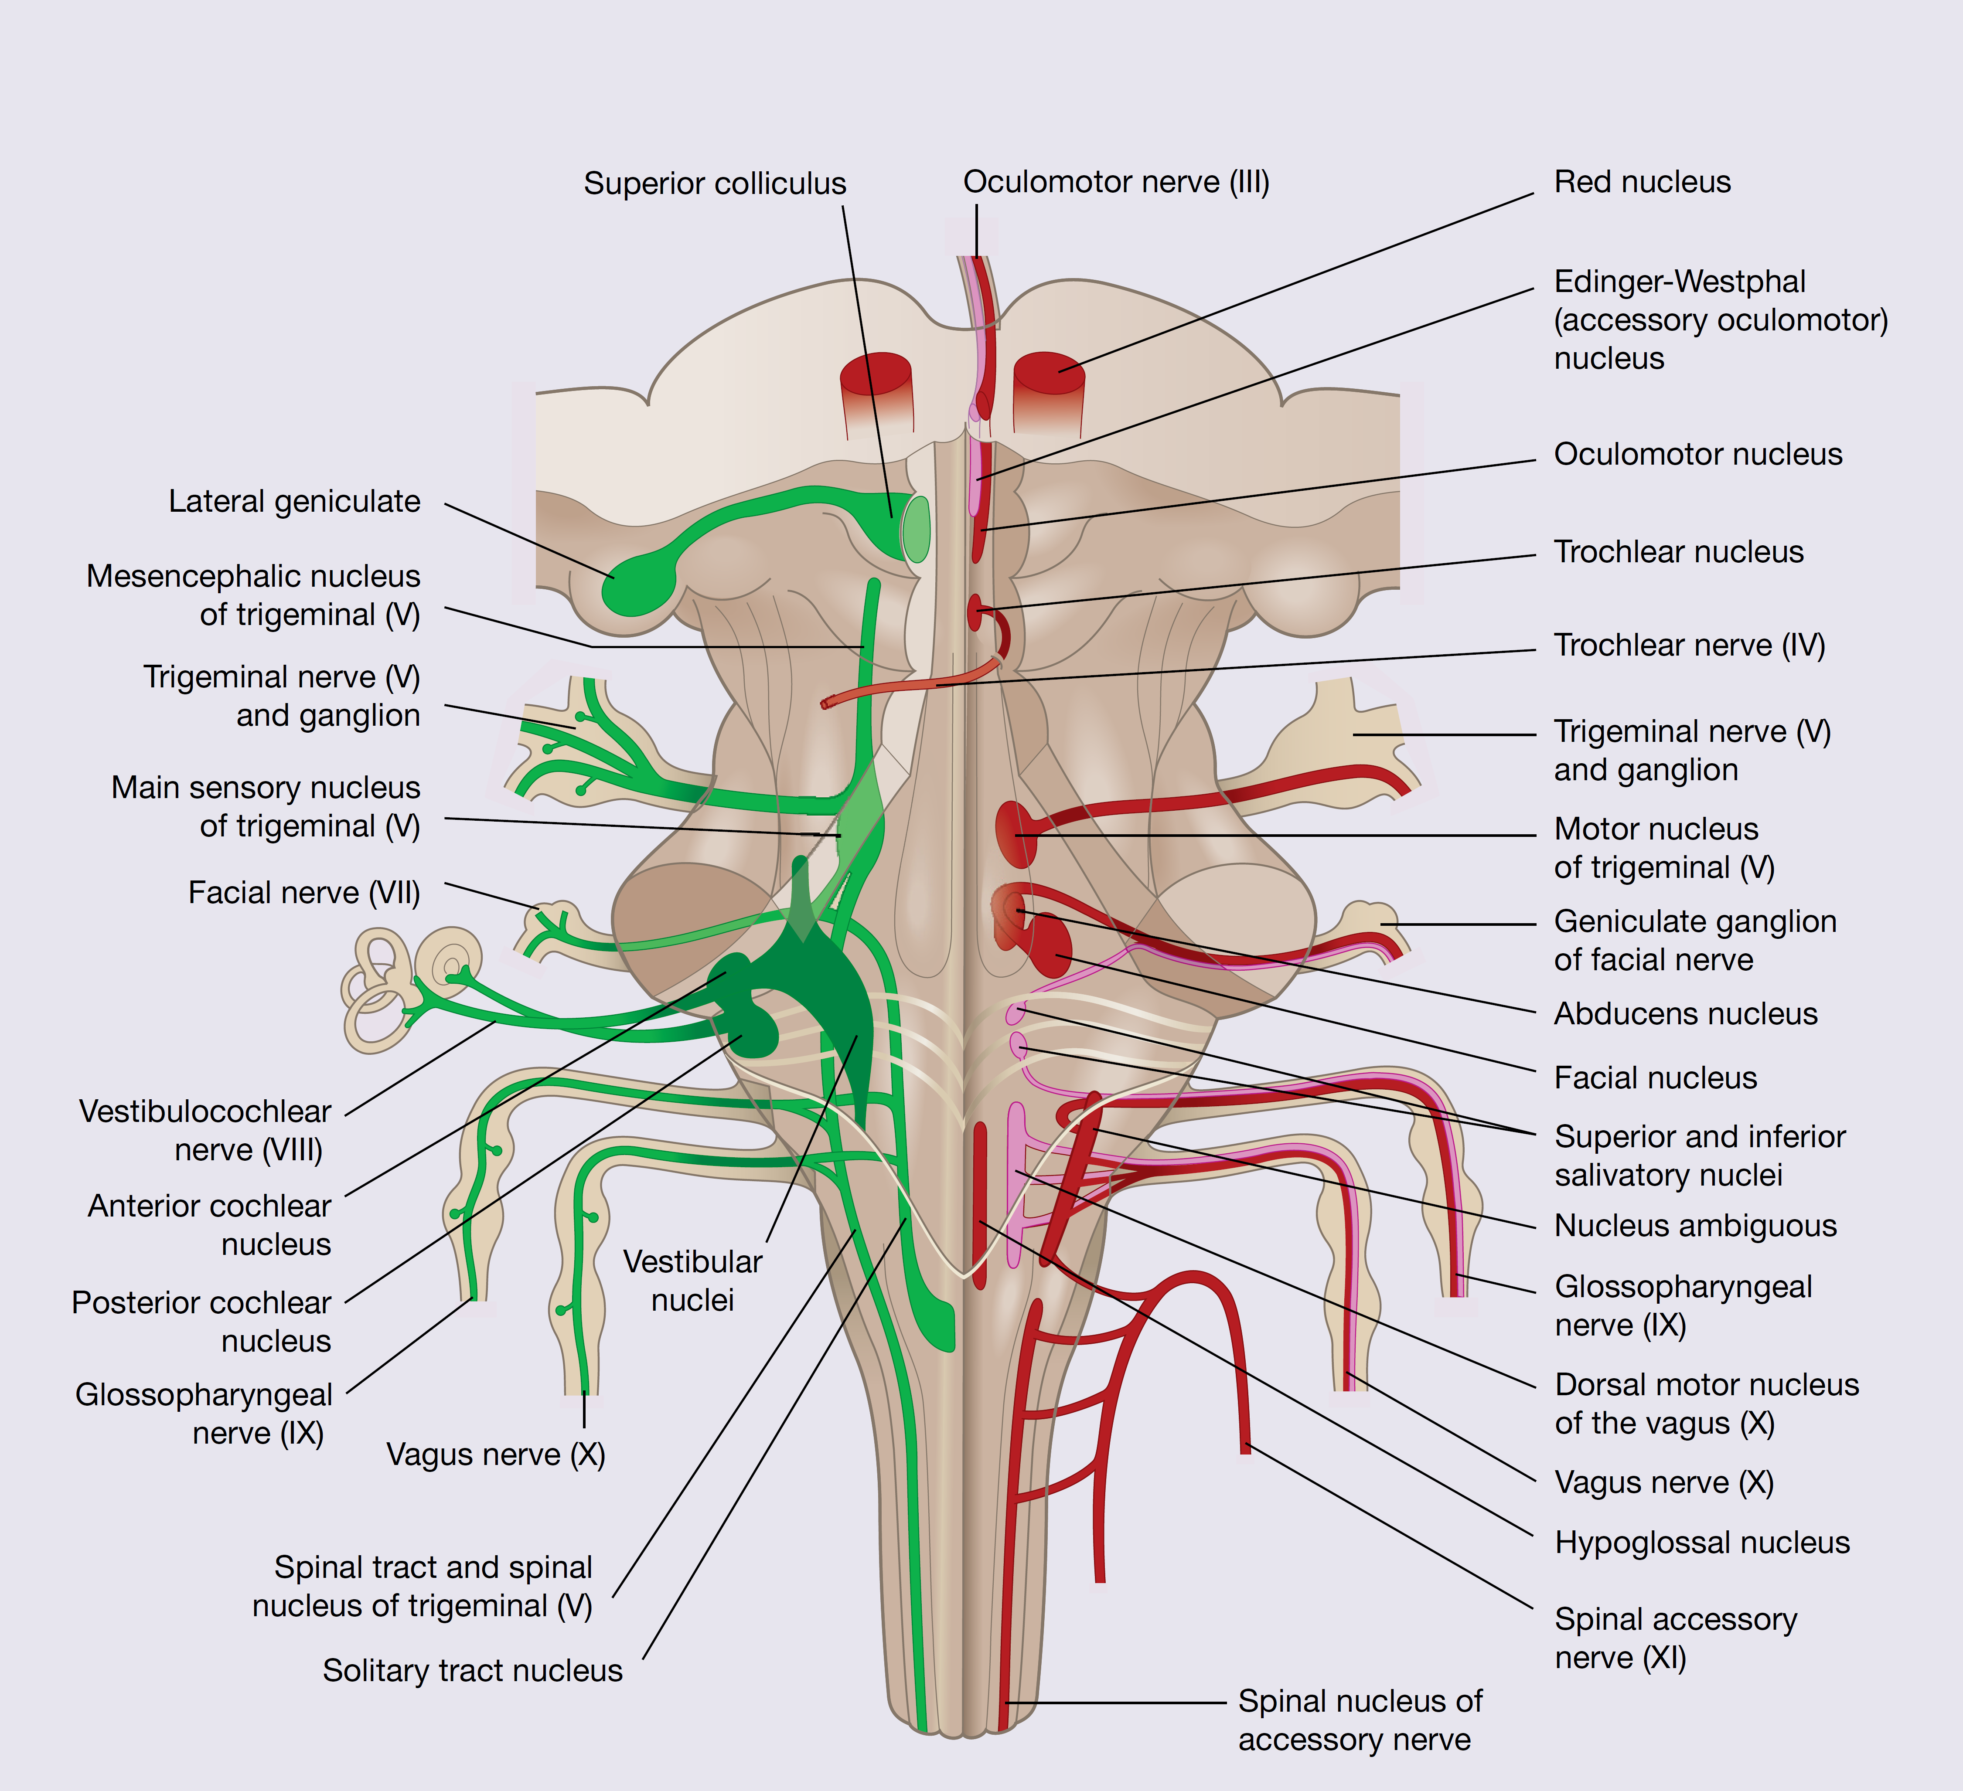
Cranial nerves of the brainstem

Slide 14
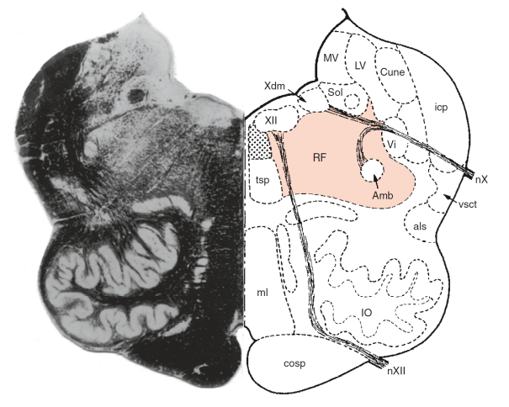
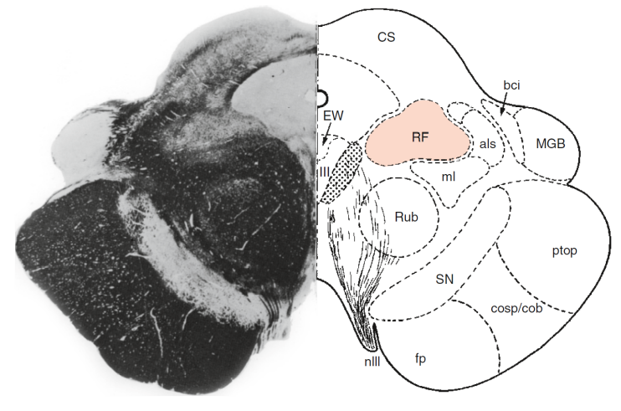
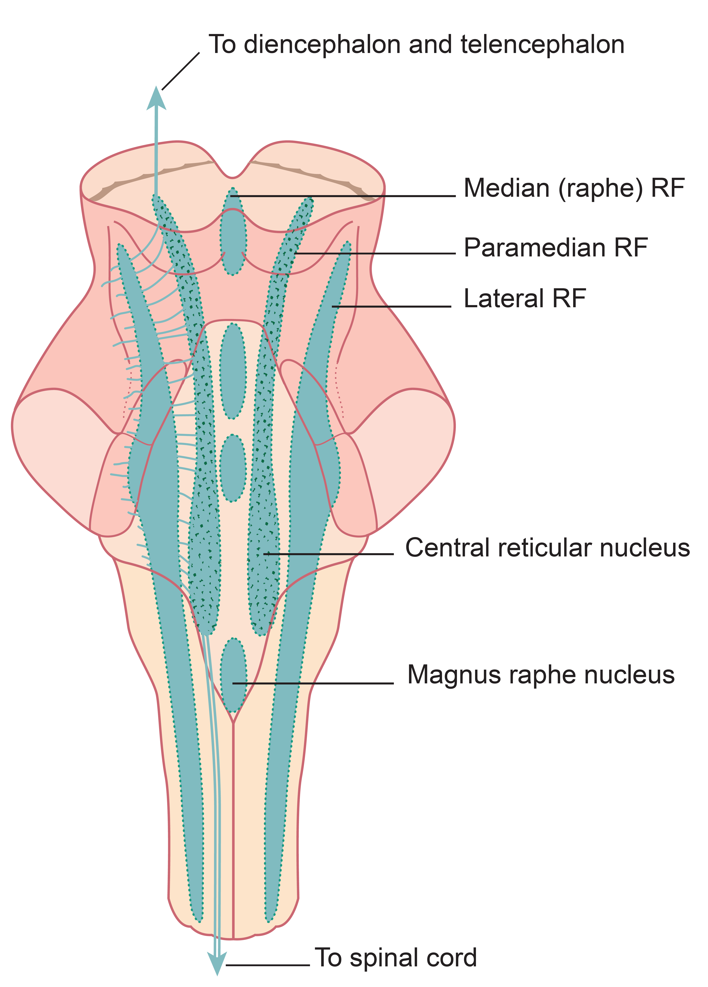
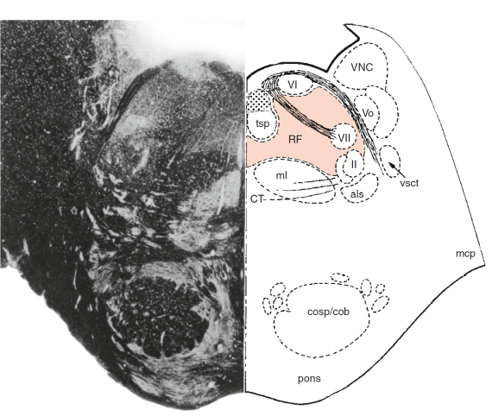
The reticular formation and raphe nuclei
Medulla
Oblungata
Midbrain
Pons
Numerous functions, including mediation of cardiovascular and respiratory functions, involvement in awareness (sleep, consciousness, alertness, habituation), pain modulation and maintenance of muscle tone, balance, and motor coordination.
Major source of serotonin in the brain

Slide 15
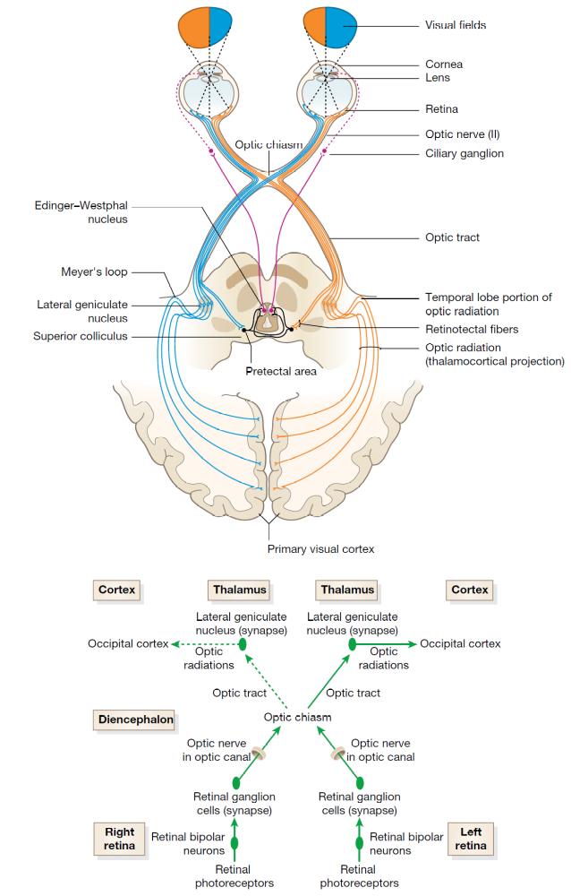
II - Optic

Slide 16
I - Olfactory

Slide 17
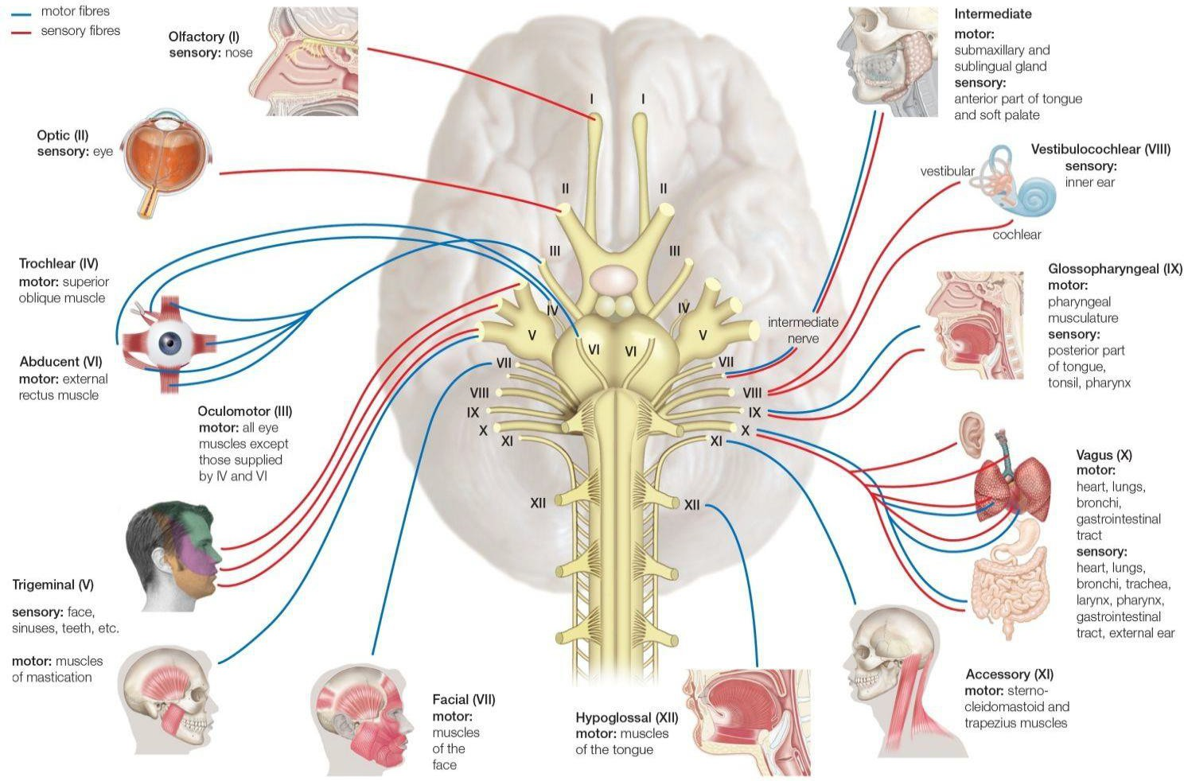
Cranial nerves
Olfactory
Optic
Oculomotor
Trochlear
Trigeminal
Abducens
Facial
Vestibulocochlear
Glossopharyngeal
Vagus
Accessory
Hypoglossal

Slide 18
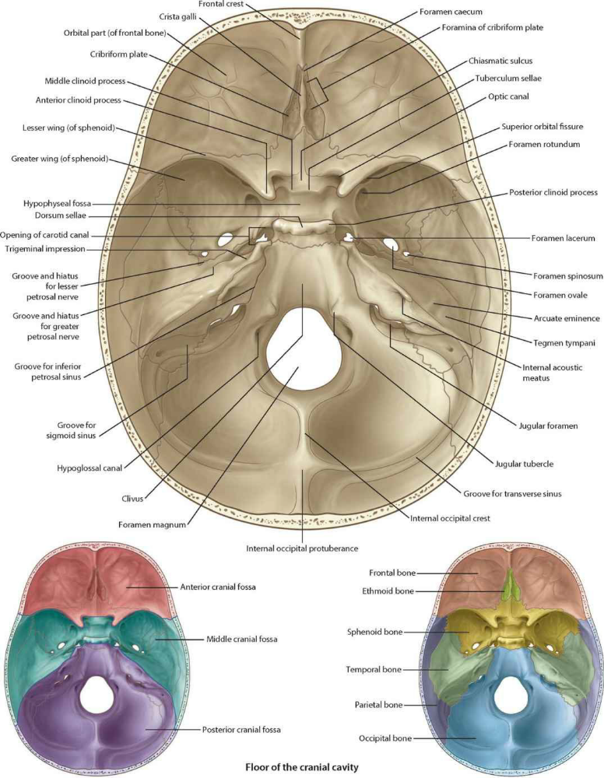
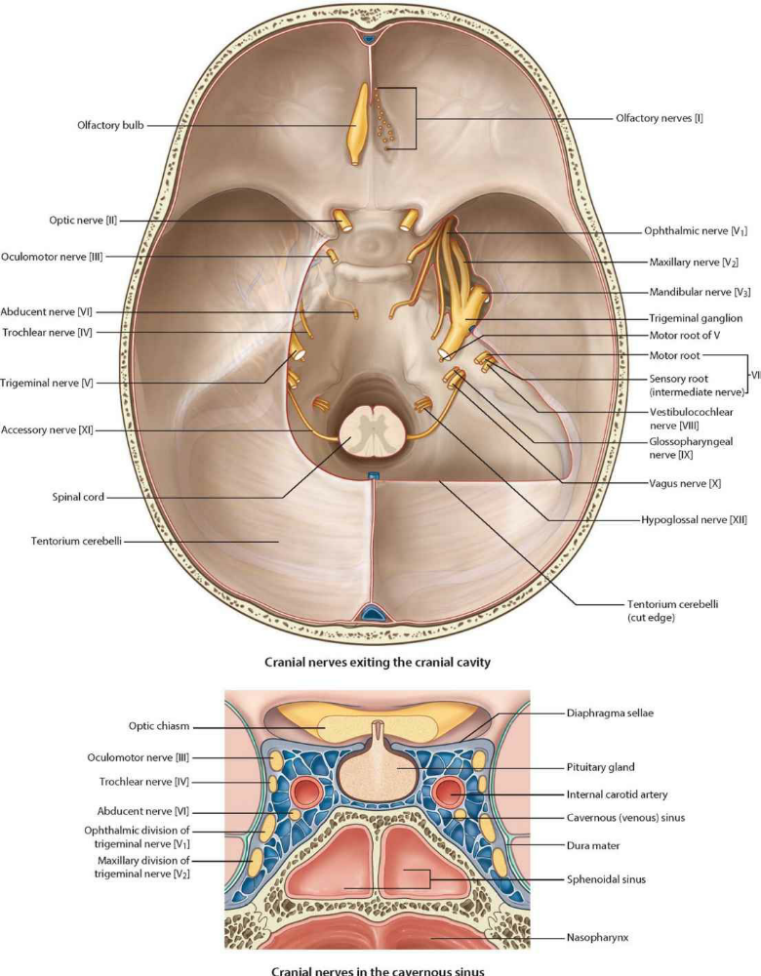
Cranial nerves and cranial cavity

Slide 19
Clinical cases

Slide 20
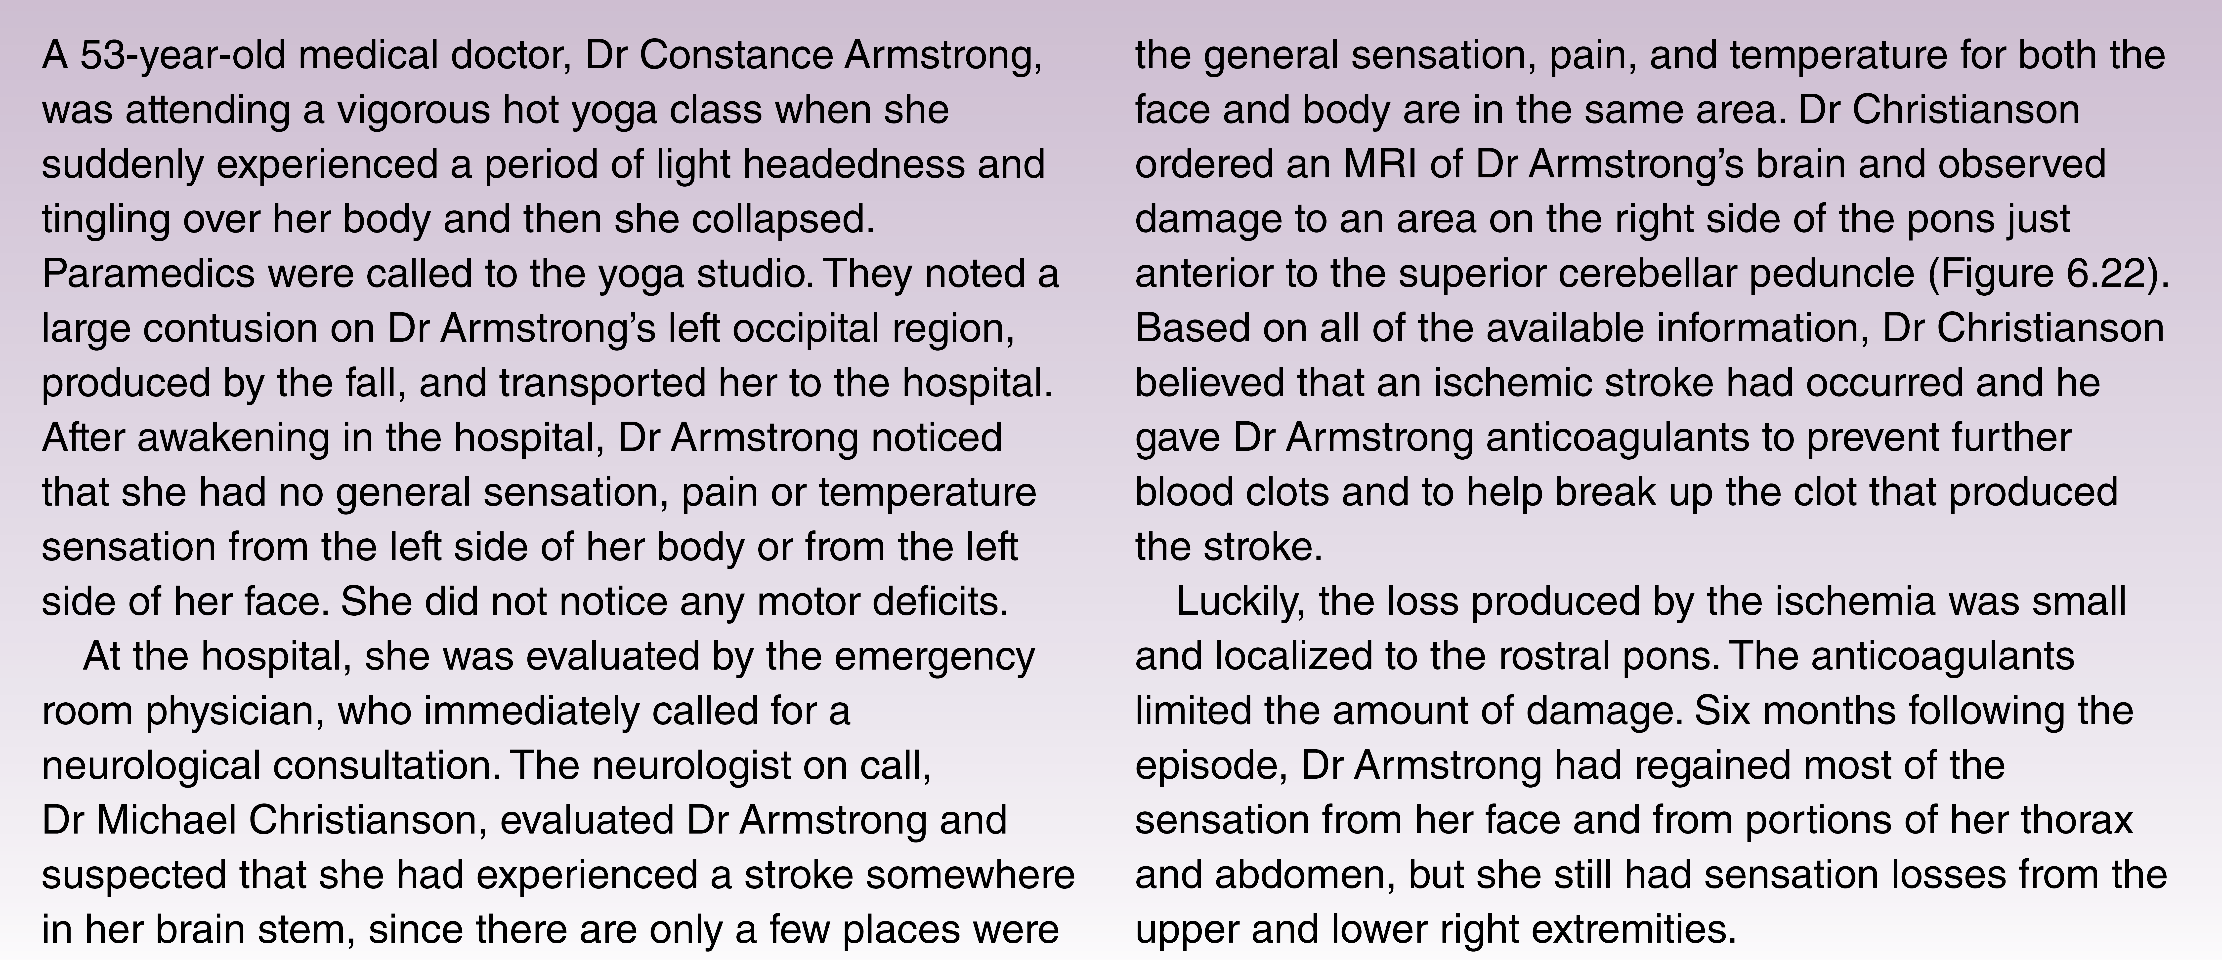
Clinical cases

